Slide 1
Pressure Tank

Slide 3
Ⅰ.What are the types of pressure tanks currently used by our company?
24 V T T S G1 S
Stainless steel cover S
(Plastic cover P, Iron cover can be omitted.)
Cover thread
Stainless steel tank S (Iron can be omitted)
Actual Capacity=Nominal Capacity
Pressure tank
Tank type: V-vertical pressure tank ,
(C-horizontal pressure tank, S-vertical flat pressure tank,
F-Vertical pressure tank with foot)
Normial Tank Capacity
Divided by colour:LEO colour-ODM,other customizable colour-OEM.

Slide 4
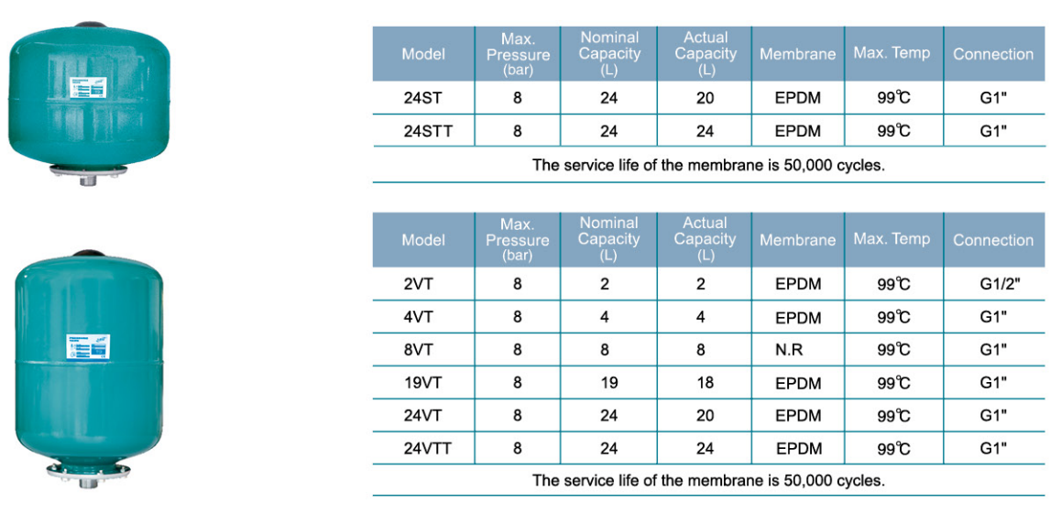
Ⅰ.What are the types of pressure tanks currently used by our company?
P.S:EPDM:A kind of synthetic material resistant to oxidation and corrosion.
NR: A natural rubber with good elasticity, high strength and comprehensive performance.
Butyl: Good stability, excellent air tightness and water tightness.

Slide 5
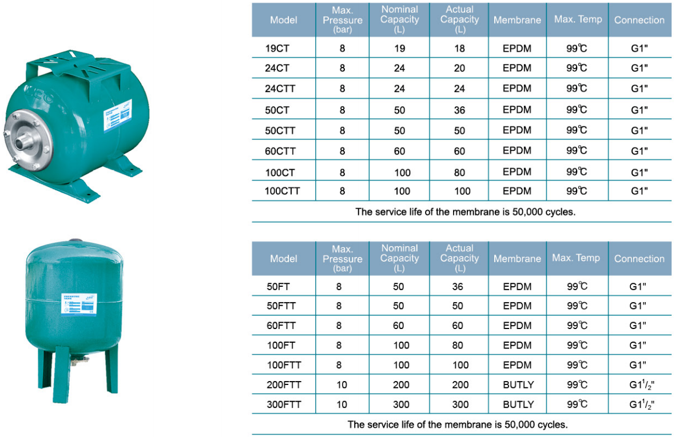
Ⅰ.What are the types of pressure tanks currently used by our company?

Slide 6
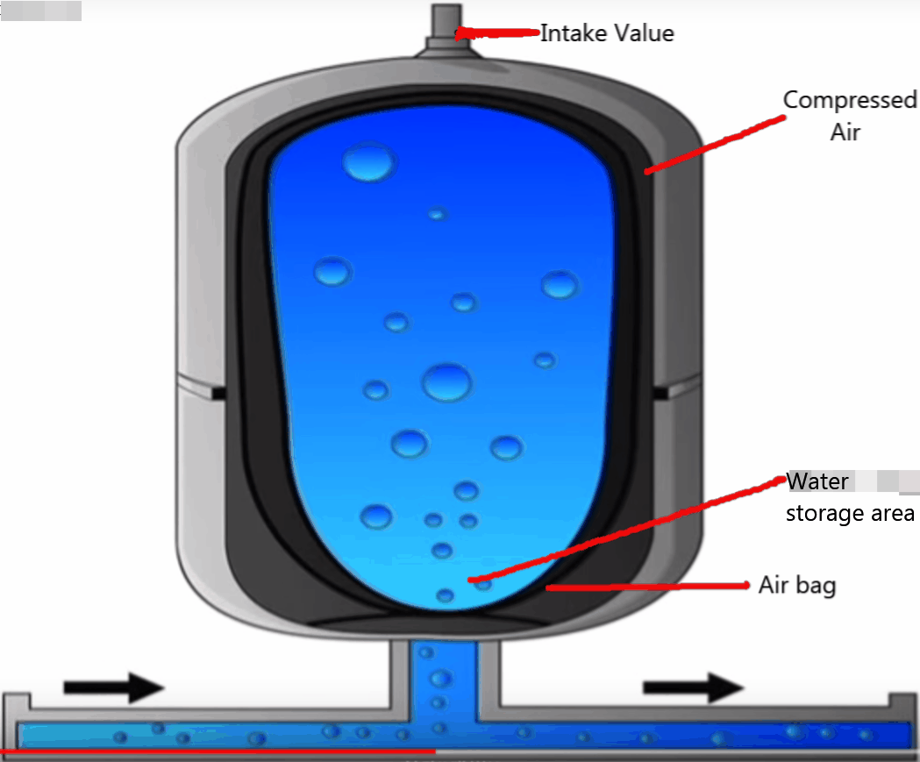

Slide 7
ⅠQ:What are the functions of the pressure tank?
Dust cover
Air pressure chamber
Intake valve
A:1.Keep water pressure stable.
2.During the working cycle of the pressure switch,prevent the micro- leakage of the pipeline or use a small amount of water from causing the pump to start frequently and affect the life of the pump.
3.Storage water.
4.Extend pump life.
Tank body
水箱
Airbag
Tank
Pressure
tank cap
Filter
Connector

Slide 8
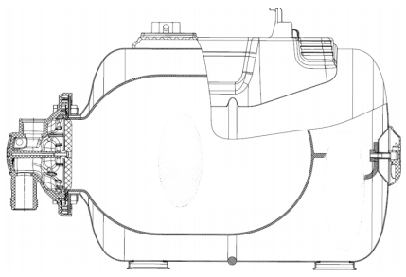
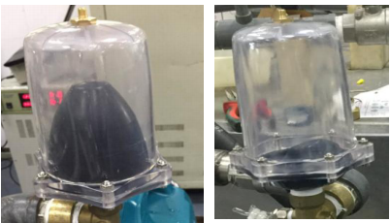
Ⅱ.What is the internal working principle of the pressure tank?
Water
Air
bag
Compressed air
Water storage area
Comp-ressed air

Slide 9
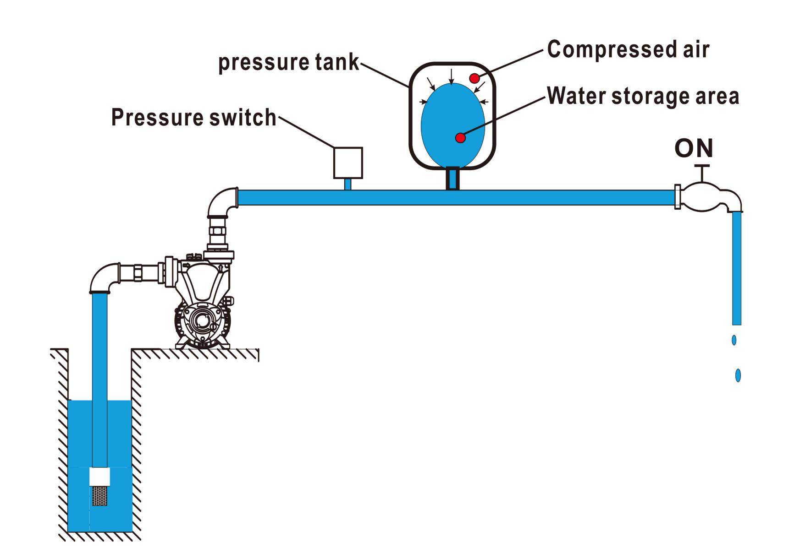
Ⅲ.Working process
Tap on
The water pressure decreased in pipeline
When air pressure > water pressure
water entering the airbag from pipeline
Water stop coming out from airbag
The air expand and
the pressure drop
Pump start
when water pressure=Pressure switch on value
Pressure switch on

Slide 10
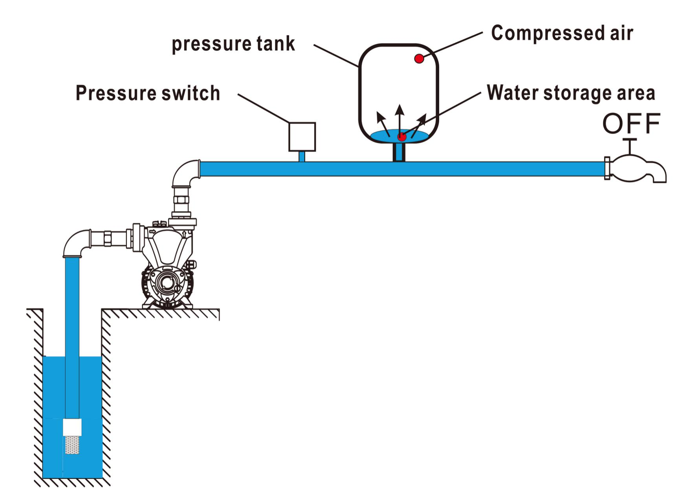
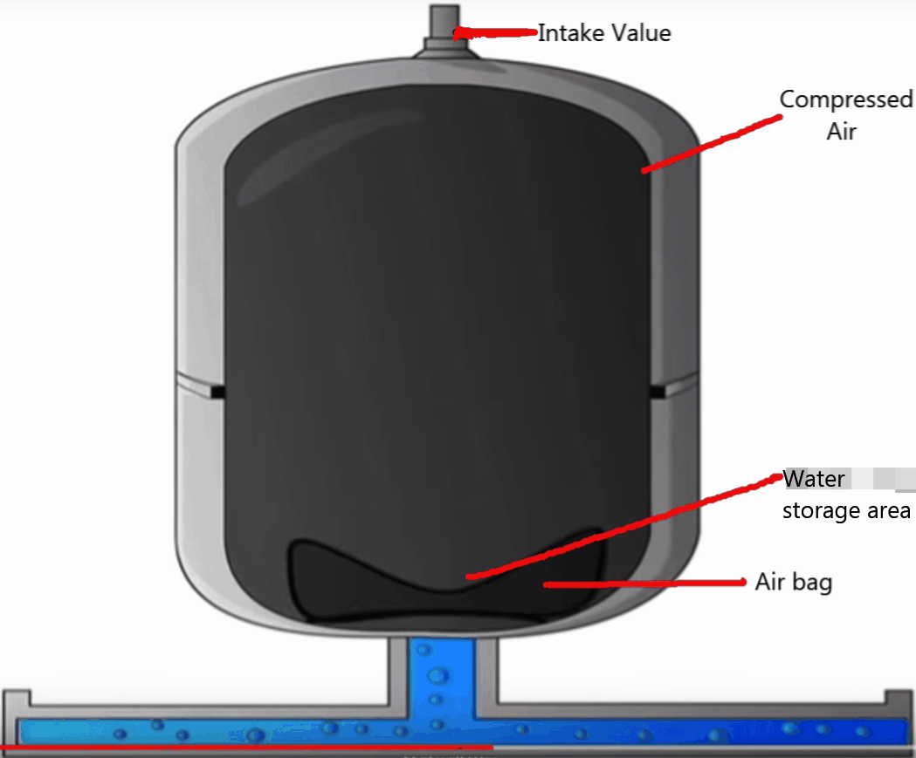
Tap off
The water pressure increased in pipeline
Water sotp entering airbag
When water pressure>air pressure
water entering the airbag from pipeline
Pump stop
The gas is compressed and
the pressure raise
Pressure switch off
when water pressure=Pressure switch off value

Slide 11
Ⅳ.State diagram
ON
Tap
OFF
OFF
FULL
FULL
Pressure tank
OUT
EMPTY
IN
ON
OFF
OFF
Pressure switch

Slide 12
Ⅴ.The difference between pressure tank system and electrinical switch
P:Water pressure < Set switch on pressure
Switch on:
E:Water pressure < Set switch on pressure + Flow
P:Automatic start-stop+Steady pressure+Storage water+Extand pump's life
Function:
E:Automatic start-stop+Dry-run protection

Slide 13
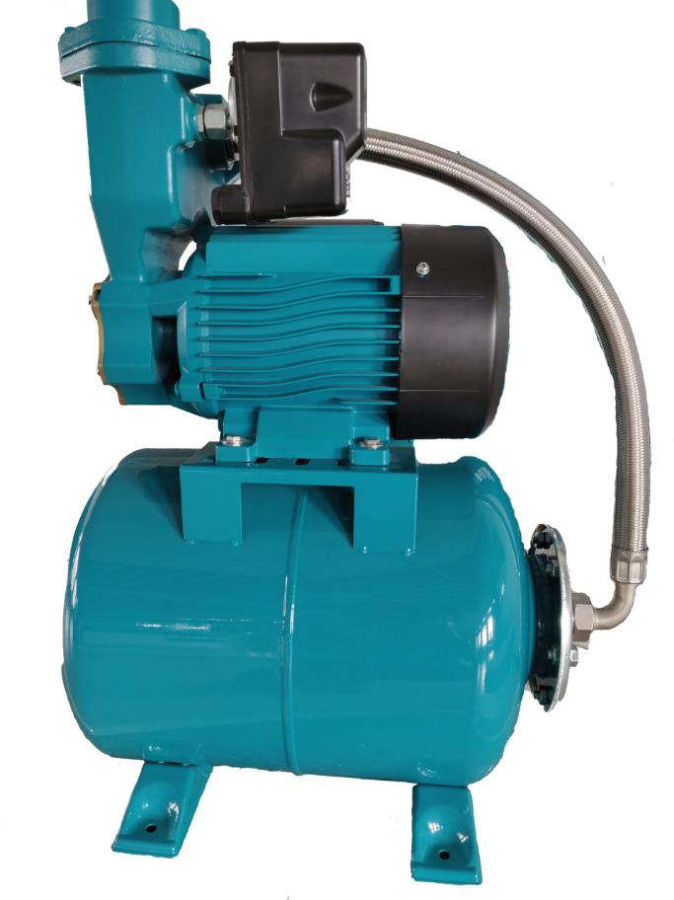

Slide 14
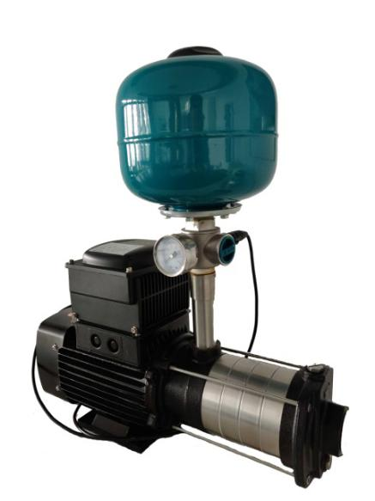
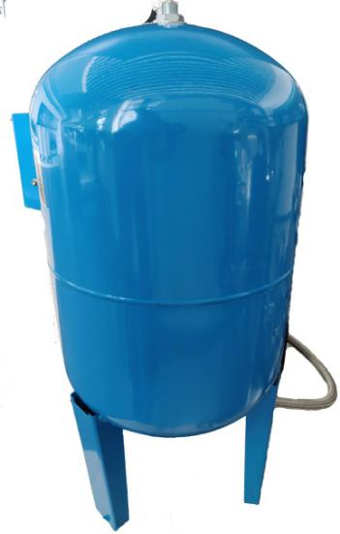
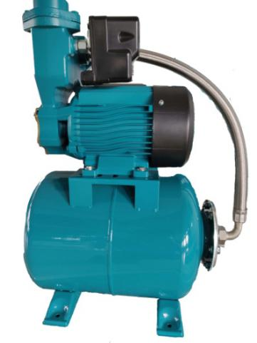
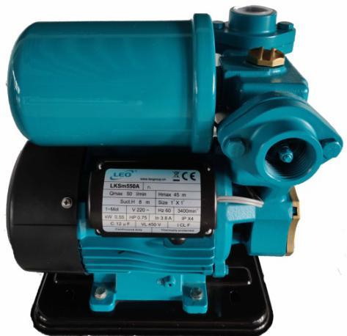
Ⅳ.Q:Where are the different types of pressure tanks used and how they are installed?
CT-
Horizontal
pressure tank
VT-
Vertical
pressure tank
ST-
Vertical flat
pressure tank
FT-
Vertical pressure
tank with foot

Slide 15
Ⅷ.How to select the right pressure tank?
Sugggestion：
V=K×Amax×（Pmax×Pmin）/[(Pmax－Pmin)×Ppro]
V:Pressure tank volume Amax：Maximum pump flow
K:Pump operating coefficient
Pmax:Pipe water pressure when the switch is off
Pmin:Pipe water pressure when the switch is on
Ppro:Pressure tank preflush pressure
The value of K at different power pumps
P(HP) | 1-2 | 2-4 | 5-8 | 9-12 | >12
K | 0.25 | 0.375 | 0.625 | 0.875 | 1
1HP=0.75KW

Slide 17
Ⅰ.What are the key parts of the pressure tank? How long is its life?
What are the factors that affect life?
Key parts：Airbag, valve core, tank body
Life：The garden pump has a regular durability of 2500h (24h continuous operation).
Factors:
1,Corrosive media may corrode airbags
2,The aging of the airbag
3,The wear between the airbag and the tank
4,There may be burrs on the inner wall of the tank to damage the airbag

Slide 18
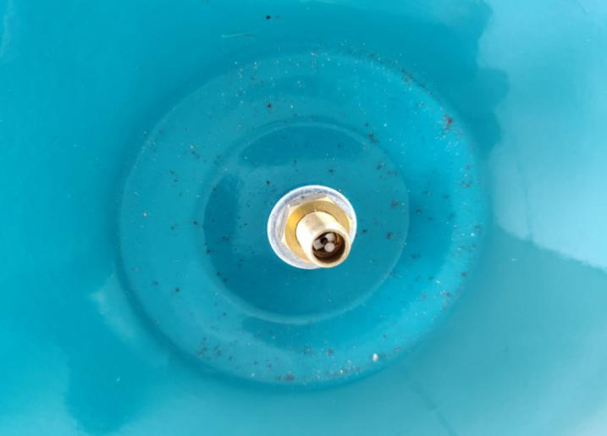
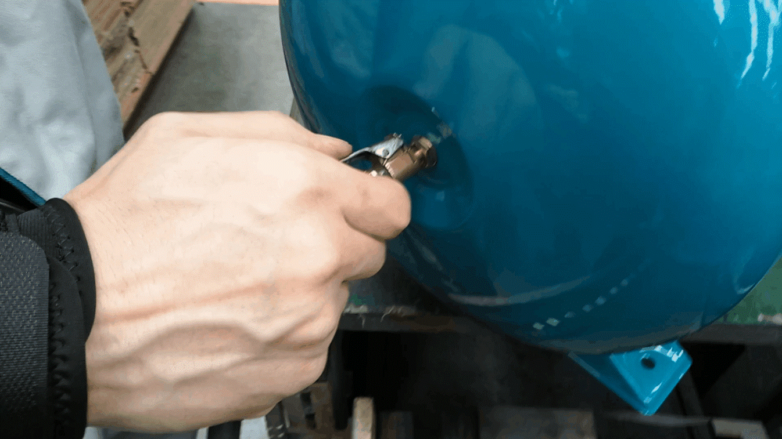
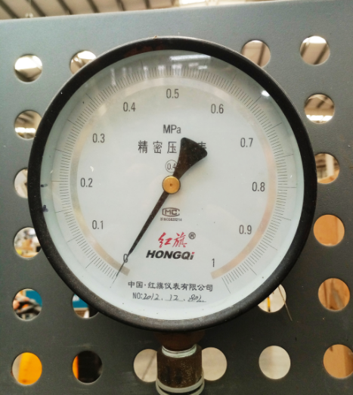
Ⅱ.How does the pressure tank inflate? What are the points of attention?
If the air pressure is insufficient, we will use the device to inflate and test.
Equipment: compressed air inflatable gun,pressure gauge
Attention:1.Refer to the pressure gauge to ensure accurate air filling.
2.Do not damage the valve core.

Slide 19
TIP:
1.In LEO, most of the preflush pressure value is equal to the starting value of the pressure switch,about 1.6bar.
Tank body:Iron
2.Standard configuration: Plastic pump:PA6-GF25
Tank cap
Others:ST12
P.S:Stainless steel material is available on request.
3.Generally speaking, the tank body engraved with Leo logo, unless the customer has a request.
4.It is not recommended that customers replace air bags by themselves.On the one hand, the sealing of gas tank cannot be guaranteed;On the other hand, the replacement cost is too high.

